Slide 1
微積分
1090409 演練課

Slide 2
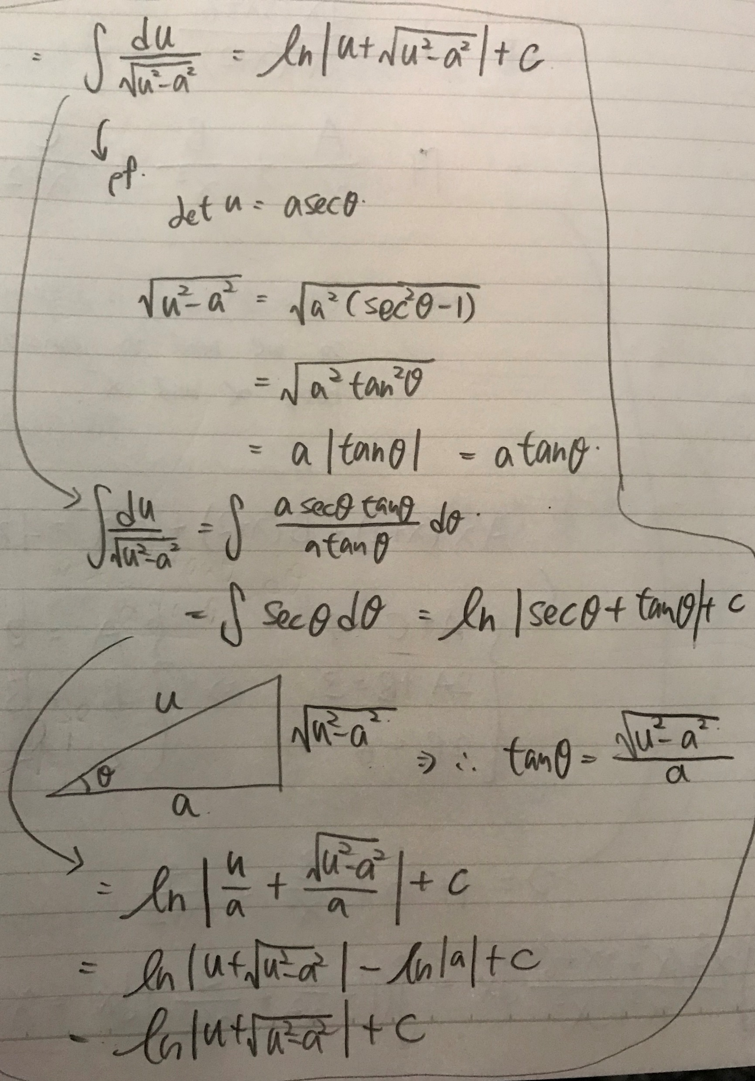

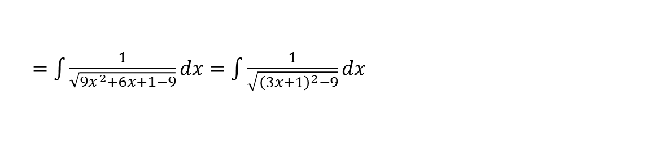
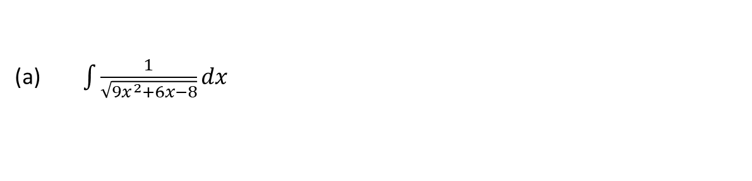

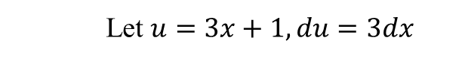
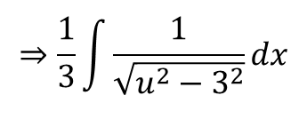
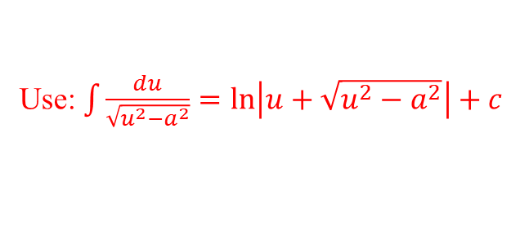
(20 points) Evaluate each of the following integrals.
$\int{\frac{1}{\sqrt{{9x}^{2}+6x−8}}}dx$
$=\int{\frac{1}{\sqrt{{9x}^{2}+6x+1−9}}}dx=\int{\frac{1}{\sqrt{{\left(3x+1\right)}^{2}−9}}}dx$
Use: $\int{\frac{du}{\sqrt{u^{2}−a^{2}}}}=\ln\left|u+\sqrt{u^{2}−a^{2}}\right|+c$
Let $u=3x+1, du=3dx$
$$⇒\frac{1}{3}\int{\frac{1}{\sqrt{u^{2}−3^{2}}}}dx$$
$$=\frac{1}{3}\ln\left|3x+1+\sqrt{u^{2}−a^{2}}\right|+c$$
$=\frac{1}{3}\ln\left|3x+1+\sqrt{{\left(3x+1\right)}^{2}−9}\right|+c$.

Slide 3
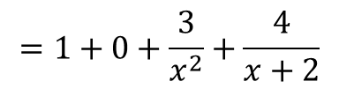
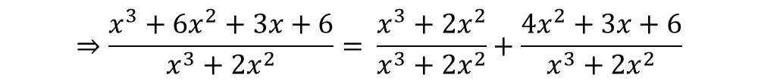
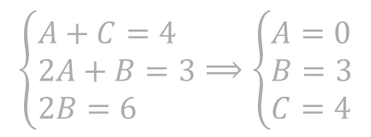
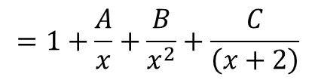
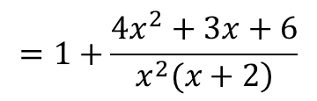
1.(b) $\int{\frac{x^{3}+{6x}^{2}+3x+6}{x^{3}+{2x}^{2}}}dx$
1
$$⇒\frac{x^{3}+{6x}^{2}+3x+6}{x^{3}+{2x}^{2}}= \frac{x^{3}+{2x}^{2}}{x^{3}+{2x}^{2}}+\frac{{4x}^{2}+3x+6}{x^{3}+{2x}^{2}}$$
$$=1+\frac{{4x}^{2}+3x+6}{\left.x^{2}(x+2\right)}$$
$$⇒Ax\left(x+2\right)+B\left(x+2\right)+Cx^{2}={4x}^{2}+3x+6$$
$$\left\{\begin{aligned}&A+C=4 \\ &2A+B=3 \\ &2B=6\end{aligned}\right.⟹\left\{\begin{aligned}&A=0 \\ &B=3 \\ &C=4\end{aligned}\right.$$
$$=1+\frac{A}{x}+\frac{B}{x^{2}}+\frac{C}{\left(x+2\right)}$$
$$=1+0+\frac{3}{x^{2}}+\frac{4}{x+2}$$

Slide 4
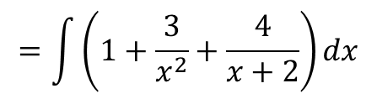
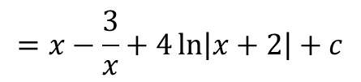
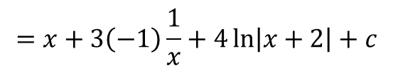
1.(b) $\int{\frac{x^{3}+{6x}^{2}+3x+6}{x^{3}+{2x}^{2}}}dx$
$$=\int{\left(1+\frac{3}{x^{2}}+\frac{4}{x+2}\right)}dx$$
$$=x+3\left(−1\right)\frac{1}{x}+4\ln\left|x+2\right|+c$$
$$=x−\frac{3}{x}+4\ln\left|x+2\right|+c$$

Slide 5
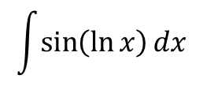
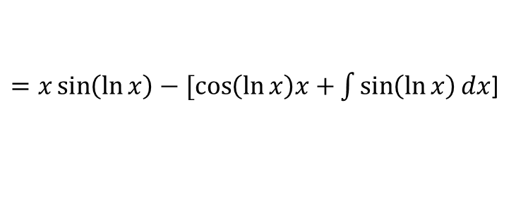
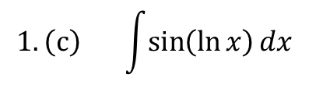
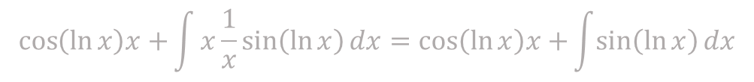
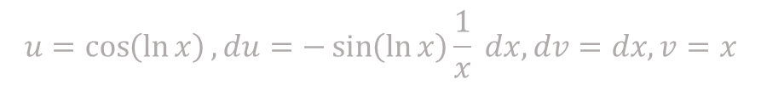
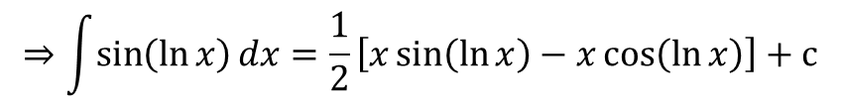

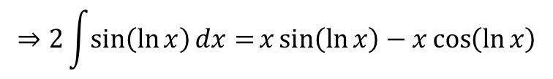
$$1.\left(c\right) \int{\sin\left(\ln{x}\right)}dx$$
Let $u=\sin{(\ln{x})}, du=\cos{(\ln{x})}\frac{1}{x}dx, dv=dx, v=x$
$$=x\sin\left(\ln{x}\right)−\int{x\frac{1}{x}\cos\left(\ln{x}\right)dx}=x\sin\left(\ln{x}\right)−\int{\cos\left(\ln{x}\right)dx}$$
$$u=\cos\left(\ln{x}\right), du=−\sin\left(\ln{x}\right)\frac{1}{x} dx, dv=dx, v=x$$
$$\cos\left(\ln{x}\right)x+\int{x\frac{1}{x}\sin\left(\ln{x}\right)dx}=\cos\left(\ln{x}\right)x+\int{\sin\left(\ln{x}\right)dx}$$
$$\int{\sin\left(\ln{x}\right)}dx$$
$=x\sin\left(\ln{x}\right)−[\cos\left(\ln{x}\right)x+\int{\sin\left(\ln{x}\right)dx}$]
$$⇒2\int{\sin\left(\ln{x}\right)dx=}x\sin\left(\ln{x}\right)−x\cos\left(\ln{x}\right)$$
$$⇒\int{\sin\left(\ln{x}\right)dx}=\frac{1}{2}\left[x\sin\left(\ln{x}\right)−x\cos\left(\ln{x}\right)\right]+c$$

Slide 6
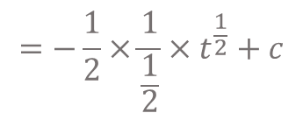
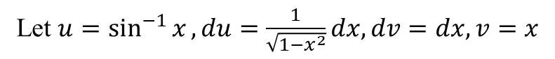
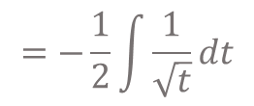
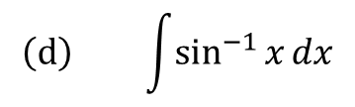
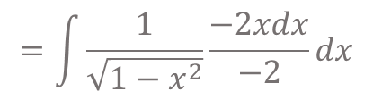
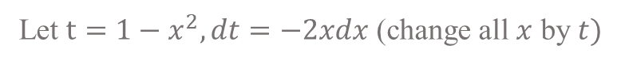
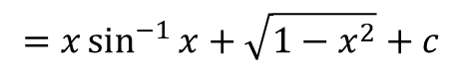
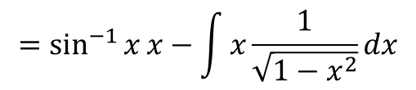
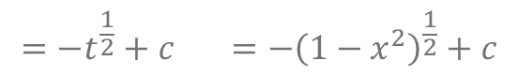
$$\left(d\right) \int{\sin^{−1}{x}}dx$$
Let $u=\sin^{−1}{x}, du=\frac{1}{\sqrt{1−x^{2}}}dx, dv=dx, v=x$
$$=\sin^{−1}{x}x−\int{x\frac{1}{\sqrt{1−x^{2}}}}dx$$
Let $t=1−x^{2}, dt=−2xdx$ (change all $x$ by $t)$
$$=\int{\frac{1}{\sqrt{1−x^{2}}}\frac{−2xdx}{−2}}dx$$
$$=−\frac{1}{2}\int{\frac{1}{\sqrt{t}}}dt$$
$$=−\frac{1}{2}×\frac{1}{\frac{1}{2}}×t^{\frac{1}{2}}+c$$
$$=−t^{\frac{1}{2}}+c =−{\left(1−x^{2}\right)}^{\frac{1}{2}}+c$$
$$=x\sin^{−1}{x}+\sqrt{1−x^{2}}+c$$

Slide 7
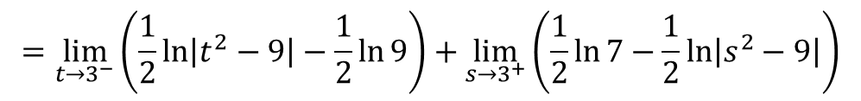
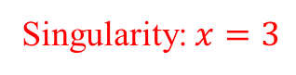
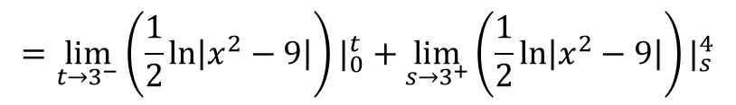
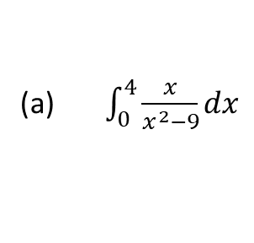
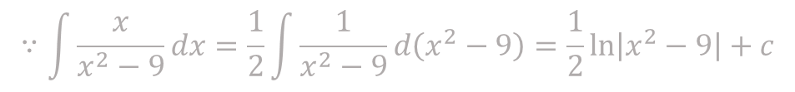
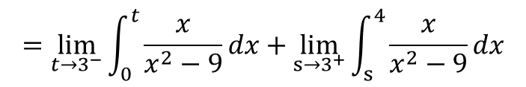
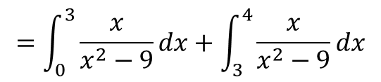
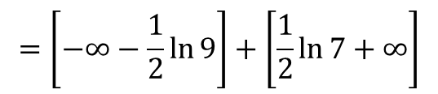
2. (10 points) Determine each of the following integrals converges or diverges? If the integral converges, find its value
(a) $\int_{0}^{4}{\frac{x}{x^{2}−9}}dx$
$$=\lim_{t→3^{−}}\left(\frac{1}{2}\ln\left|x^{2}−9\right|\right)|_{0}^{t}+\lim_{s→3^{+}}\left(\frac{1}{2}\ln\left|x^{2}−9\right|\right)|_{s}^{4}$$
Singularity: $x=3$
$$=\int_{0}^{3}{\frac{x}{x^{2}−9}}dx+\int_{3}^{4}{\frac{x}{x^{2}−9}}dx$$
$$=\lim_{t→3^{−}}\left(\frac{1}{2}\ln\left|t^{2}−9\right|−\frac{1}{2}\ln{9}\right)+\lim_{s→3^{+}}\left(\frac{1}{2}\ln{7}−\frac{1}{2}\ln\left|s^{2}−9\right|\right)$$
Improper Integral TYPE 2
$$=\left[−∞−\frac{1}{2}\ln{9}\right]+\left[\frac{1}{2}\ln{7}+∞\right]$$
$$=\lim_{t→3^{−}}{\int_{0}^{t}{\frac{x}{x^{2}−9}}}dx+\lim_{s→3^{+}}{\int_{s}^{4}{\frac{x}{x^{2}−9}}}dx$$
Diverges
$$∵\int{\frac{x}{x^{2}−9}}dx=\frac{1}{2}\int{\frac{1}{x^{2}−9}d\left(x^{2}−9\right)}=\frac{1}{2}\ln\left|x^{2}−9\right|+c$$

Slide 8
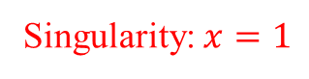
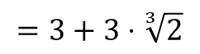
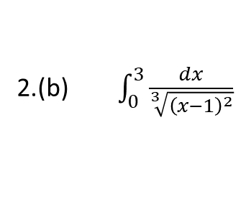
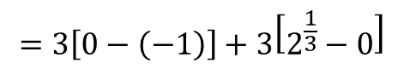
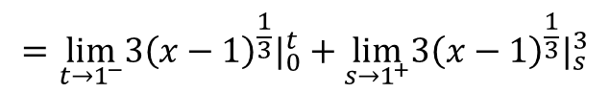
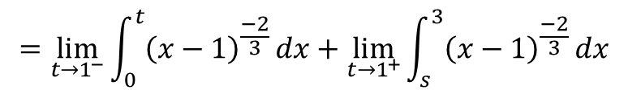
2.(b) $\int_{0}^{3}{\frac{dx}{\sqrt[3]{{\left(x−1\right)}^{2}}}}$
Singularity: $x=1$
$$=\lim_{t→1^{−}}\int_{0}^{t}{{\left(x−1\right)}^{\frac{−2}{3}}}dx+\lim_{t→1^{+}}\int_{s}^{3}{{\left(x−1\right)}^{\frac{−2}{3}}}dx$$
$$=\lim_{t→1^{−}}3{\left(x−1\right)}^{\frac{1}{3}}|_{0}^{t}+\lim_{s→1^{+}}3{\left(x−1\right)}^{\frac{1}{3}}|_{s}^{3}$$
$$=3\left[0−\left(−1\right)\right]+3\left[2^{\frac{1}{3}}−0\right]$$
$$=3+3⋅\sqrt[3]{2}$$

Slide 9
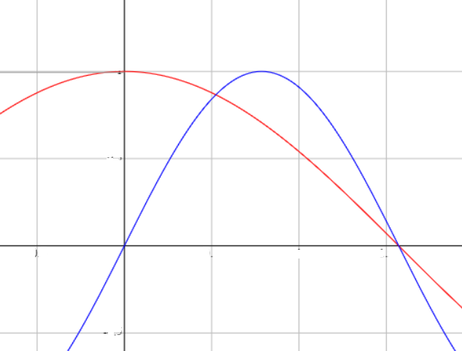
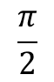
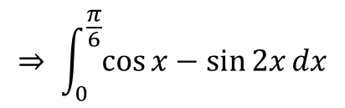
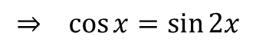
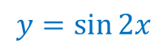
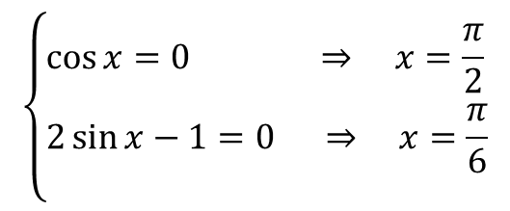






3. (6 points) Find the area of the region enclosed by $y=\cos{x}$ and $y=\sin{2x}$ for $0≤x≤\frac{π}{2}$
Find the intersection
$$⇒ cos{x}=\sin{2x}$$
$$⇒ cos{x}=2\sin{x}\cos{x}$$
$$⇒ cos{x}\left(2\sin{x}−1\right)=0$$
$$0$$
$$\frac{π}{6}$$
$$\frac{π}{2}$$
$y=\cos{x}$
$$y=\sin{2x}$$
$$\left\{\begin{aligned}&\cos{x}=0 ⇒ x=\frac{π}{2} \\ &2\sin{x}−1=0 ⇒ x=\frac{π}{6} \\ &\end{aligned}\right.$$
$$⇒ \int_{0}^{\frac{π}{6}}{\cos{x}−\sin{2x}}dx$$
$$+\int_{\frac{π}{6}}^{\frac{π}{2}}{\sin{2x}}−\cos{x}dx$$

Slide 10





3.
$$⇒ \int_{0}^{\frac{π}{6}}{\cos{x}−\sin{2x}}dx+\int_{\frac{π}{6}}^{\frac{π}{2}}{\sin{2x}}−\cos{x}dx$$
$$=\sin{x}+\frac{1}{2}{\left.\cos{2x}\right]}_{0}^{\frac{π}{6}}+{\left.\left(\frac{−1}{2}\cos{2x}−\sin{x}\right)\right]}_{\frac{π}{6}}^{\frac{π}{2}}$$
$$=\left(\frac{1}{2}+\frac{1}{4}−0−\frac{1}{2}\right)+\left(\frac{−1}{2}\left(−1\right)−1+\frac{1}{4}+\frac{1}{2}\right)$$
$$=\frac{1}{4}+\frac{1}{4}$$
$$=\frac{1}{2}$$

Slide 11






4. (6 points) Find the number $a$ such that the line $x=a$ bisects the area under the curve $y=\frac{1}{x^{2}}$ for $1≤x≤4$.
$y=\frac{1}{x^{2}}$ , Let $x=a$.
Line x= $a$ can bisect the area under the curve $y=\frac{1}{x^{2}}$
$$⇒so \int_{1}^{a}{\frac{1}{x^{2}}}dx=\int_{a}^{4}{\frac{1}{x^{2}}}dx$$
$$⇒ { −\left[\frac{1}{x}\right]}_{1}^{a}=−{\left[\frac{1}{x}\right]}_{a}^{4}$$
$⇒ \frac{1}{−\text{a}}+1$ $=\frac{1}{−4}+\frac{1}{a}$
$$⇒a=\frac{8}{5}$$

Slide 12




5. (8 points) Find the number $b$ such that the line $y=b$ bisects the area under the curve $y=\frac{1}{x^{2}}$ for $1≤x≤4$.
$⇒$Bisects area $=\int_{1}^{\frac{8}{5}}{\frac{1}{x^{2}}}dx =\frac{3}{8}$
$$=\frac{3}{8}$$
$y=b$
1
4

Slide 13





$$\int_{\frac{1}{16}}^{b}{\left(x−1\right)}dy$$
5.
$$= \int_{\frac{1}{16}}^{b}{\left(\frac{1}{\sqrt{y}}−1\right)}dy$$
$$(4, \frac{1}{16})$$
$y=b$
$$y=\frac{1}{16}$$
1
4
$$\left(4−1\right)∗\frac{1}{16} =\frac{3}{16}$$

Slide 14










5.
$$\int_{\frac{1}{16}}^{b}{\left(\frac{1}{\sqrt{y}}−1\right)}dy$$
${\frac{3}{16}+\left({2y}^{\frac{1}{2}}−y\right)|}_{\frac{1}{16}}^{b}=$ $\frac{3}{8}$
$$\frac{3}{16}$$
$$⇒\frac{3}{16}+2\sqrt{b}−b−2\sqrt{\frac{1}{16}}+\frac{1}{16}=\frac{3}{8}$$
$$⇒64b^{2}−176b+25=0$$
$$⇒b=\frac{176±\sqrt{{176}^{2}−4×64×25}}{2×64}$$
$$=\frac{176±64\sqrt{6}}{128}$$
$\int_{\frac{1}{16}}^{b}{\left(\frac{1}{\sqrt{y}}−1\right)}dy+\frac{3}{16} =$ $\frac{3}{8}$
$$=\frac{11±4\sqrt{6}}{8}$$
$$b=\frac{11−4\sqrt{6}}{8}$$

Slide 15














6. (12 points) Find the volume of the solid obtained from rotating the region bounded by the given curves about the specified line.
$\left(a\right) y=\frac{1}{4}x^{2}, x=2, y=0$, about the y-axis
$$π\left[2^{2}−x^{2}\right]dy$$
$$=π\left[2^{2}−{\left(2\sqrt{y}\right)}^{2}\right]dy$$
$$(2,1)$$
$$⇒\int_{0}^{1}{π\left[2^{2}−{\left(2\sqrt{y}\right)}^{2}\right]}dy$$
$$y=1$$
$$=π\int_{0}^{1}{(4−4y)}dy$$
$$dy$$
$$={π\left(4y−2y^{2}\right)|}_{0}^{1}$$
$$0$$
$$2$$
$$=π\left(4−2\right)$$
$$=2π$$

Slide 16












6(b) $y=0, y=x^{2}, x=0, x=1,$about the $x$-axis
$$y=x^{2}$$
$dV=πy^{2}$dx
$$V=\int_{0}^{1}{πy^{2}}dx$$
$$dx$$
$$=\int_{0}^{1}{πx^{4}}dx$$
$$=π\frac{1}{5}{\left.x^{5}\right|}_{0}^{1}$$
$$y=0$$
$$0$$
$$1$$
$$=\frac{π}{5}\left(1−0\right)$$
$$=\frac{π}{5}$$

Slide 17











7. (14 points) Use the method of cylindrical shells to find the volume generated by rotating the region bounded by the given curves about the specified axis
$$2−x=2−\left(y^{2}+1\right)=1−y^{2}$$
(a)$x=y^{2}+1, x=2$, about $y=−2$
$d$y
$$y−(−2)$$
$$x=y^{2}+1$$
$d$y
$$dV=2π\left(y+2\right)\left( 1−y^{2}\right)dy$$
$$y=−2$$
$$V=\int_{−1}^{1}{2π}\left(y+2\right)\left( 1−y^{2}\right)dy$$
X=$2$

Slide 18






7.(a)
$$V=\int_{−1}^{1}{2π}\left(y+2\right)\left( 1−y^{2}\right)dy$$
$$=2π\int_{−1}^{1}{\left(y−y^{3}+2+2y^{2}\right)}dy$$
$$=2π{\left[\frac{1}{2}y^{2}−\frac{1}{4}y^{4}+2y−{\frac{2}{3}y}^{3}\right]}_{−1}^{1}$$
$$=2π\left[\frac{1}{2}−\frac{1}{4}+2−\frac{2}{3}−\left(\frac{1}{2}−\frac{1}{4}−2+\frac{2}{3}\right)\right]$$
$$=2π\left[\frac{8}{3}\right]$$
$$=\frac{16}{3}π$$

Slide 19











$7.\left(b\right) y=e^{{−x}^{2}}, y=0, x=0, x=1,$ about the y-axis
$$dx$$
$$x$$
$$y$$
$$dx$$
$$dv=2πydx$$
$y=$0
$$=2πxe^{{−x}^{2}}dx$$
X=$0$
X=$1$
$$V=\int_{0}^{1}{2πxe^{{−x}^{2}}}dx$$

Slide 20









$$7.\left(b\right)$$
$$V=\int_{0}^{1}{2πxe^{{−x}^{2}}}dx$$
$$=2π\int_{0}^{1}{xe^{{−x}^{2}}}dx$$
$$=π\left({−e}^{−u}\right)|_{0}^{1}$$
$$=2π\int_{0}^{1}{\frac{1}{2}2xe^{{−x}^{2}}}dx$$
$$=−π\left(e^{−1}−1\right)$$
$$=π\left(1−\frac{1}{e}\right)$$
$$let u=x^{2}$$
$$=2π\int_{0}^{1}{\frac{1}{2}e^{−u}}du$$

Slide 21










8. Use the cylindrical shells to find the volume of solid: a right circular cone with height $h$ and base radius $r$.
$$dx$$
$$x$$
$$dx$$
$$h−y$$
$$r$$
$$h$$
$$r:h=x:y$$
$$y=\frac{hx}{r}$$
$$dv=2πx(h−\frac{hx}{r})dx$$
$$=2πh (x−\frac{x^{2}}{r})dx$$
$$V=2πh\int_{0}^{r}{(x−\frac{x^{2}}{r})}dx$$

Slide 22






8.
$$V=2πh\int_{0}^{r}{(x−\frac{x^{2}}{r})}dx$$
$$=2πh(\frac{1}{2}x^{2}−\frac{1}{3}\frac{x^{3}}{r})|_{0}^{r}$$
$$=2πh(\frac{1}{2}r^{2}−\frac{1}{3}\frac{r^{3}}{r})$$
$$=2πh(\frac{3r^{2}−2r^{2}}{6})$$
$$=2πh(\frac{r^{2}}{6})$$
$$=\frac{1}{3}πr^{2}h$$

Slide 23











9. (16 points) Find the exact length of each of the following curves
$$\left(a\right) y=\ln\left(\sec\left(x\right)\right), 0≤x≤\frac{π}{4}$$
$$review$$
$$y=f(x)$$
$$dL=\sqrt{{dx}^{2}+{dy}^{2}}$$
$$dL$$
$$=\sqrt{1+{(\frac{dy}{dx})}^{2}} dx$$
$$dy$$
$$dx$$
$$L=\int_{a}^{b}{\sqrt{1+{(\frac{dy}{dx})}^{2}} dx}$$
$$a$$
$$b$$

Slide 24








9$.\left(a\right) y=\ln\left(\sec\left(x\right)\right), 0≤x≤\frac{π}{4}$
$$L=\int_{0}^{π/4}{\sqrt{1+{(\frac{dy}{dx})}^{2}}}dx$$
$$⇒ \frac{dy}{dx}=\frac{1}{secx}secx tanx$$
$$={\left.\ln\left|\sec{x}+\tan{x}\right|\right]}_{0}^{\frac{π}{4}}$$
$$=tanx$$
$$=\int_{0}^{π/4}{\sqrt{1+\tan^{2}{x}}}dx$$
$$=\ln\left(\sqrt{2}+1\right)$$
$$=\int_{0}^{π/4}{\sec{x}}dx$$

Slide 25










$$9.\left(b\right) x=\frac{y^{4}}{8}+\frac{1}{{4y}^{2}} , 1≤y≤2$$
$$L=\int_{a}^{b}{\sqrt{1+{(\frac{dy}{dx})}^{2}} dx}$$
$$=\int_{1}^{2}{\sqrt{1+\frac{y^{6}}{4}−\frac{1}{2}+\frac{y^{−6}}{4}}}dy$$
$$=\int_{a}^{b}{\sqrt{1+{(\frac{dx}{dy})}^{2}} dy}$$
$$=\int_{1}^{2}{\frac{y^{3}}{2}+\frac{y^{−3}}{2}}dy$$
$$={\left.\frac{y^{4}}{8}−\frac{y^{−2}}{4}\right]}_{1}^{2}$$
$$⇒\frac{dx}{dy}=\frac{y^{3}}{2}−\frac{y^{−3}}{2}$$
$${\left(\frac{dx}{dy}\right)}^{2}=\frac{y^{6}}{4}−\frac{1}{2}+\frac{y^{−6}}{4}$$
$$=\left(\frac{16}{8}−\frac{1}{16}\right)−\left(\frac{1}{8}−\frac{1}{4}\right)$$
$$=\frac{33}{16}$$

Slide 26







10. (20 points) Find the area of the surface obtained from rotating each of the following curves about the specified axis.
(a) $x^{2}+y^{2}=r^{2},$ about the line $y=r$
$$review$$
$$\int{2πrdl}$$
$$dl$$
$$r1$$
$$dl$$
$$r1$$

Slide 27















$$review\int{2πrdl}$$
$$l$$
$$r1$$
$$−$$
$$r1$$
$$dl$$
$$=$$
$$r2$$
$$r2$$
$$θ$$
$$l$$
$$l$$
$$⇒$$
$$r2$$
$$2πr2$$

Slide 28







$$review\int{2πrdl}$$
$$Area=πl^{2}\frac{θ}{2π}$$
$$θ$$
$$=\frac{1}{2}l^{2}θ$$
$$l$$
$$⇒2πl×\frac{θ}{2π}=2πr2$$
$$⇒θ=\frac{2πr2}{l}$$
$$2πr2$$
$$=\frac{1}{2}l^{2}×\frac{2πr2}{l}$$
$$=2πrl$$

Slide 29















$$review\int{2πrdl}$$
$$l_{1}$$
$$l_{1}$$
$$r_{1}$$
$$r_{1}$$
$$−$$
$$r_{1}$$
$$dl$$
$$=$$
$$l_{2}$$
$$r_{2}$$
$$r_{2}$$
$$=πr_{2}\left(l_{1}+l_{2}\right)−πr_{1}l_{1}$$
相似三角形
$$=π[\left(r_{2}−r_{1}\right)l_{1}+r_{2}l_{2}]$$
$$\frac{l_{1}}{r_{1}}=\frac{l_{1}+l_{2}}{r_{2}}$$
$$=π[r_{1}l_{2}+r_{2}l_{2}]$$
$⇒r_{2}l_{1}=r_{1}l_{1}$+ $r_{1}l_{2}$
$$=2πrl$$
$$⇒{(r}_{2}{−r_{2})l}_{1}=r_{1}l_{2}$$

Slide 30











10.(a) $x^{2}+y^{2}=r^{2},$ about the line $y=r$
$$\int{2πrdl}$$
$$y$$
$$S_{1}=\int_{−r}^{r}{2π\left(r−y\right)}\sqrt{1+{(\frac{dy}{dx})}^{2}}dx$$
$$s_{1}$$
$$y=r$$
$$=\int_{−r}^{r}{2π\left(r−\sqrt{r^{2}−x^{2}}\right)}\sqrt{1+\frac{x^{2}}{r^{2}−x^{2}}}dx$$
$$x$$
$$s_{2}$$
$$y=−r$$
$$=4π\int_{0}^{r}{\left(\frac{r^{2}}{\sqrt{r^{2}−x^{2}}}−r\right)}dx$$

Slide 31


10.(a) $x^{2}+y^{2}=r^{2},$ about the line $y=r$
$$\int{2πrdl}$$
$$y$$
$$S_{2}=\int_{−r}^{r}{2π\left(y−(−r)\right)}\sqrt{1+{(\frac{dy}{dx})}^{2}}dx$$
$$s_{1}$$
$$y=r$$
$$x$$
$$=4π\int_{0}^{r}{\left(\frac{r^{2}}{\sqrt{r^{2}−x^{2}}}+r\right)}dx$$
$$s_{2}$$
$$y=−r$$

Slide 32







10.(a) $x^{2}+y^{2}=r^{2},$ about the line $y=r$
$$y$$
$$S_{1}=4π\int_{0}^{r}{\left(\frac{r^{2}}{\sqrt{r^{2}−x^{2}}}−r\right)}dx$$
$$s_{1}$$
$$y=r$$
$$S_{2}=4π\int_{0}^{r}{\left(\frac{r^{2}}{\sqrt{r^{2}−x^{2}}}+r\right)}dx$$
$$x$$
$$s_{2}$$
$$y=−r$$
$$=8π\int_{0}^{r}{\left(\frac{r^{2}}{\sqrt{r^{2}+x^{2}}}\right)}dx$$
$$=8πr^{2}\frac{π}{2}$$
$⇒$ Total area $S=S_{1}+S_{2}$
$$=8π{\left[r^{2}\sin^{−1}\left(\frac{x}{r}\right)\right]}_{0}^{r}$$
$$=4π^{2}r^{2}$$

Slide 33











10.(b) $x=\frac{1}{3}{(y^{2}+2)}^{\frac{3}{2}}, 1≤y≤2,$ about the x-axis
$$\int{2πrdl}$$
$$S=\int_{1}^{2}{2πy\sqrt{1+{\left(\frac{dx}{dy}\right)}^{2}}}dy$$
$$=2π\int_{1}^{2}{y^{3}+y}dy$$
$$⇒\frac{dx}{dy}=\frac{1}{2}{\left(y^{2}+2\right)}^{\frac{1}{2}}×2y=y{\left(y^{2}+2\right)}^{\frac{1}{2}}$$
$$=2π{\left[\frac{1}{4}y^{4}+\frac{1}{2}y^{2}\right]}_{1}^{2}$$
$${\left(\frac{dx}{dy}\right)}^{2}=y^{2}\left(y^{2}+2\right)=y^{4}+2y^{2}$$
$$=\int_{1}^{2}{2πy\sqrt{1+y^{4}+2y^{2}}}dy$$
$$=2π\left(4+2−\frac{1}{4}−\frac{1}{2}\right)$$
$$=2π\int_{1}^{2}{y\sqrt{{\left(y^{2}+1\right)}^{2}}}dy$$
$$=\frac{21π}{2}$$

